Slide 1
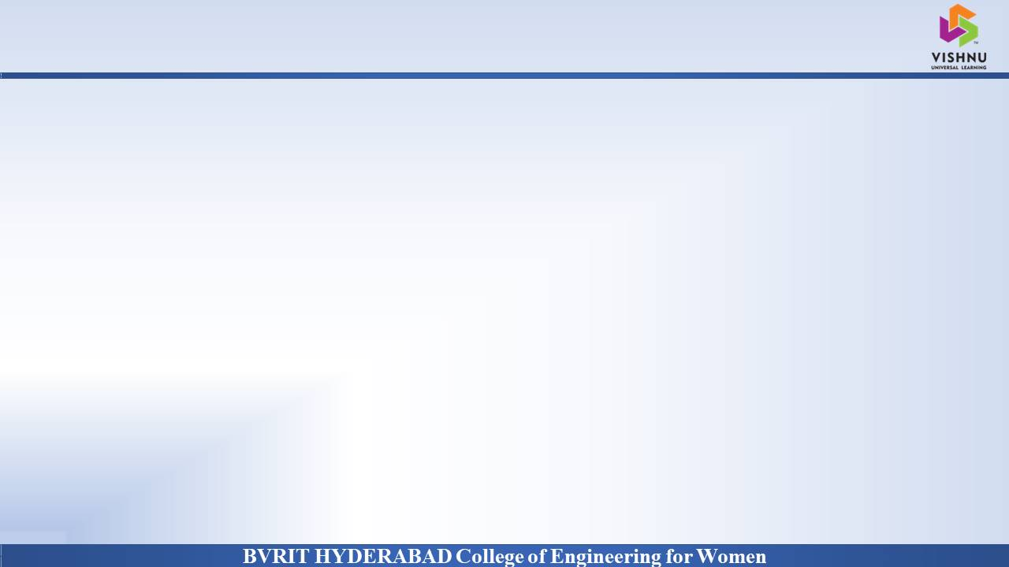
Department of Computer Science and Engineering
TEXT TO IMAGE GENERATOR
using
GENERATIVE ADVERSARIAL NETWORKS
( 28 May 2021)
Harika Devineni : 17WH1A0570
G. Jahnavi Priya : 17WH1A0573
Sanku Saii Sweta : 17WH1A05B0
Internal Guide: Prof. R.S. Murali Nath
Designation : Associate Professor

Slide 2

Abstract
Why Should I Study this course?
Synthesizing high-quality images from text descriptions is a challenging problem in computer vision and has many practical applications. Samples generated by existing text-to-image approaches can roughly reflect the meaning of the given descriptions, but they fail to contain necessary details and vivid object parts. In this project, we use Stacked Generative Adversarial Networks (StackGAN) to generate photo-realistic images conditioned on text descriptions. We decompose the hard problem into more manageable sub-problems through a sketch-refinement process. The Stage-I GAN sketches the primitive shape and colors of the object based on the given text description, yielding Stage-I low-resolution images. The Stage-II GAN takes Stage-I results and text descriptions as inputs, and generates high-resolution images with photo-realistic details. It is able to rectify defects in Stage-I results and add compelling details with the refinement process.
Examples
BVRIT HYDERABAD College of Engineering for Women

Slide 3
Architecture
Why Should I Study this course?
Data preprocessing
Stage 1 GAN
Stage 2 GAN
Upsampling Image
Results
Examples
BVRIT HYDERABAD College of Engineering for Women

Slide 4
Technology Stack
Why Should I Study this course?
Examples
Python 3.6
GloVe model
Dataset: Oxford 102 flower dataset.
Libraries Needed:
Tensor Flow
Keras
Numpy
Matplotlib
BVRIT HYDERABAD College of Engineering for Women

Slide 5
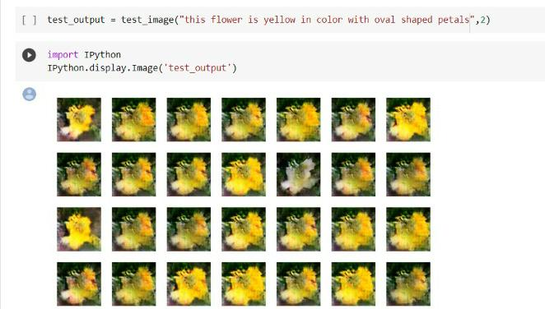
Output
Why Should I Study this course?
Examples
BVRIT HYDERABAD College of Engineering for Women

Slide 6
References
Why Should I Study this course?
Papers :
“StackGAN: Text to Photo-realistic Image Synthesis with Stacked Generative Adversarial Networks”, TaoXu, Hongsheng Li, Shaoting Zhang, Xiaogang Wang, Xiaolei Huang, Dimitris Metaxas, Hans Xang date of publication August 5, 2017
“TiVGAN: Text to Image to Video Generation With Step-by-Step Evolutionary Generator”, IEEE Access, DOYEON KIM, DONGGYU JOO and JUNMO KIM School of Electrical Engineering, Korea Advanced Institute of Science and Technology, Daejeon 34141, South Korea Corresponding author: Junmo Kim, date of publication August 19, 2020.
“A Realistic Image Generation of Face From Text Description Using the Fully Trained Generative Adversarial Networks”, MUHAMMAD ZEESHAN KHAN, SAIRA JABEEN, MUHAMMAD USMAN GHANI KHAN, TANZILA SABA, ASIM REHMAT, AMJAD REHMAN and USMAN TARIQ, date of publication August 10, 2020.
Article :
https://towardsdatascience.com/text-to-image-a3b201b003ae
Examples
BVRIT HYDERABAD College of Engineering for Women

Slide 7
Thankyou

